Slide 1
Practice Problems from Last Week
Landhills Winery
Three stages of reading:
3) How can we express these descriptions in stage 2 mathematically so that we can enter them into an optimization software and solve our production planning problem?
Decisions:

Slide 2
Objective function
Profit = Revenue – Cost
= [9(X₁₁ +X₁₂+X₁₃+X₁₄) + 9(X₂₁ +X₂₂+X₂₃+X₂₄) + 9(X₃₁ +X₃₂+X₃₃+X₃₄) +5.5(X₄₁ +X₄₂+X₄₃+X₄₄) +2.95(X₅₁ +X₅₂+X₅₃+X₅₄)] –
[2.35(X₁₁ +X₂₁+X₃₁+X₄₁ +X₅₁) + 2.6(X₁₂ +X₂₂+X₃₂+X₄₂ +X₅₂) + 2.10(X₁₃ +X₂₃+X₃₃+X₄₃ +X₅₃) +1.55(X₁₄ +X₂₄+X₃₄+X₄₄ +X₅₄)]
=[(9 – 2.35) X₁₁ +(9 – 2.6) X₁₂ +(9 – 2.10) X₁₃ +(9 – 1.55) X₁₄
+(9 – 2.35) X₂₁ +(9 – 2.6) X₂₂+(9 – 2.10) X₂₃ +(9 – 1.55) X₂₄
+(9 – 2.35) X₃₁ +(9 – 2.6) X₃₂ +(9 – 2.10) X₃₃ +(9 – 1.55) X₃₄
+(5.5 – 2.35) X₄₁ +(5.5 – 2.6) X₄₂ +(5.5 – 2.10) X₄₃ +(5.5 – 1.55) X₄₄
+(2.95 – 2.35) X₅₁ +(2.95 – 2.6) X₅₂ +(2.95 – 2.10) X₅₃ +(2.95 – 1.55) X₅₄]

Slide 3
Objective function continued….
⇨ Profit= [6.65 X₁₁ +6.4 X₁₂ +6.9 X₁₃ +7.45 X₁₄
+6.65 X₂₁ +6.4 X₂₂+6.9 X₂₃ +7.45 X₂₄
+6.65 X₃₁ +6.4 X₃₂ +6.9 X₃₃ +7.45 X₃₄
+3.15 X₄₁ +2.9 X₄₂ +3.4 X₄₃ +3.95 X₄₄
+0.6 X₅₁ +0.35 X₅₂ +0.85 X₅₃ +1.4 X₅₄]

Slide 4
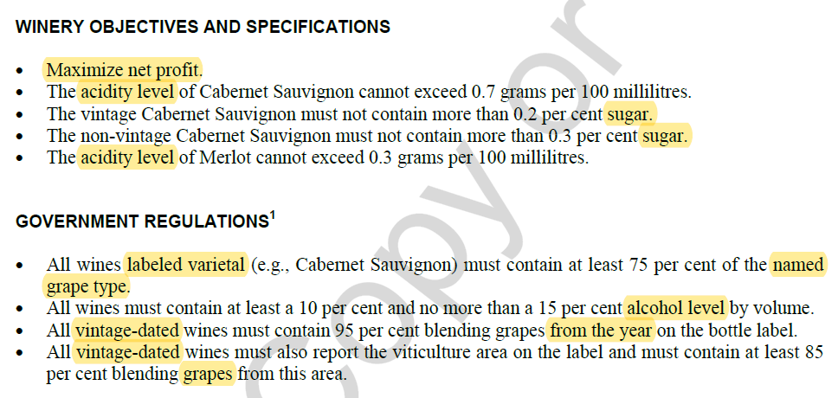
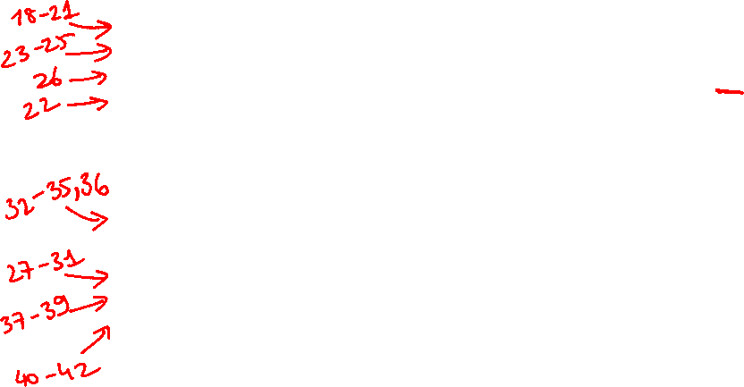

Slide 5
Acidity Coefficient for Cabernet Sauvignon(row 18-21)
= [X₁₁(bottles) * 7.5 (100ml)*0.35 (gm/) + X₁₂*7.5*0.75 + X₁₃*7.5*0.55 + X₁₄*7.5*0.25]
(bottle) (100 ml)
<=0.7
[X₁₁(bottles)*7.5 (100ml) + X₁₂*7.5 + X₁₃*7.5 + X₁₄*7.5 ]
(bottle)
= 7.5[X₁₁*0.35 + X₁₂*0.75 + X₁₃*0.55 + X₁₄*0.25] (gm) <=0.7
7.5 [ X₁₁ + X₁₂ + X₁₃ + X₁₄ ] (100ml)
= X₁₁*0.35 + X₁₂*0.75 + X₁₃*0.55 + X₁₄*0.25 <= 0.7[ X₁₁ + X₁₂ + X₁₃ + X₁₄ ]
= X₁₁*0.35 + X₁₂*0.75 + X₁₃*0.55 + X₁₄*0.25 – 0.7*X₁₁ – 0.7*X₁₂ – 0.7*X₁₃ – 0.7* X₁₄ <= 0
= (-0.35)X₁₁ + (0.05)X₁₂ + (-0.15)X₁₃ + (-0.45)X₁₄ <=0

Slide 6

Acidity Coefficient for Merlot(Row 22)
= [X₅₁(bottles) * 7.5 (100ml)*0.35 (gm/) + X₅₂*7.5*0.75 + X₅₃*7.5*0.55 + X₅₄*7.5*0.25]
(bottle) (100 ml)
<= 0.3
[X₅₁(bottles)*7.5 (100ml) + X₅₂*7.5 + X₅₃*7.5 + X₅₄*7.5 ]
(bottle)
= 7.5[X₅₁*0.35 + X₅₂*0.75 + X₅₃*0.55 + X₅₄*0.25] (gm) <= 0.3
7.5 [ X₅₁ + X₅₂ + X₅₃ + X₅₄ ] (100ml)
= X₅₁*0.35 + X₅₂*0.75 + X₅₃*0.55 + X₅₄*0.25 <= 0.3[ X₅₁ + X₅₂ + X₅₃ + X₅₄ ]
= X₅₁*0.35 + X₅₂*0.75 + X₅₃*0.55 + X₅₄*0.25 – 0.3*X₅₁ – 0.3*X₅₂ – 0.3*X₅₃ – 0.3* X₅₄ <= 0
= (0.05)X₅₁ + (0.45)X₅₂ + (0.25)X₅₃ + (-0.05)X₅₄ <=0

Slide 7
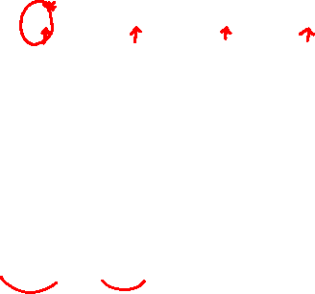
Sugar Coefficient for Vintage Cabernet Sauvignon(row 23-25)
= [X₁₁ 0.12 + X₁₂*0.25 + X₁₃*0.3 + X₁₄*0.08] <= 0.2
[X₁₁+ X₁₂ + X₁₃ + X₁₄ ]
= [X₁₁*0.12 + X₁₂*0.25 + X₁₃*0.3 + X₁₄*0.08] <= 0.2
[ X₁₁ + X₁₂ + X₁₃ + X₁₄ ]
= X₁₁*0.12 + X₁₂*0.25 + X₁₃*0.3 + X₁₄*0.08 <= 0.2[ X₁₁ + X₁₂ + X₁₃ + X₁₄ ]
= X₁₁*0.12 + X₁₂*0.25 + X₁₃*0.3 + X₁₄*0.08 – 0.2*X₁₁ – 0.2*X₁₂ – 0.2*X₁₃ – 0.2* X₁₄ <= 0
= (-0.08)X₁₁ + (0.05)X₁₂ + (0.1)X₁₃ + (-0.12)X₁₄ <=0

Slide 8
Sugar Coefficient for Non-Vintage Cabernet Sauvignon(row 26)
= [X₁₁ 0.12 + X₁₂*0.25 + X₁₃*0.3 + X₁₄*0.08] <= 0.3
[X₁₁+ X₁₂ + X₁₃ + X₁₄ ]
= X₁₁*0.12 + X₁₂*0.25 + X₁₃*0.3 + X₁₄*0.08 <= 0.3[ X₁₁ + X₁₂ + X₁₃ + X₁₄ ]
= X₁₁*0.12 + X₁₂*0.25 + X₁₃*0.3 + X₁₄*0.08 – 0.3*X₁₁ – 0.3*X₁₂ – 0.3*X₁₃ – 0.3* X₁₄ <= 0
= (-0.18)X₁₁ + (-0.05)X₁₂ + (0)X₁₃ + (-0.22)X₁₄ <=0

Slide 9
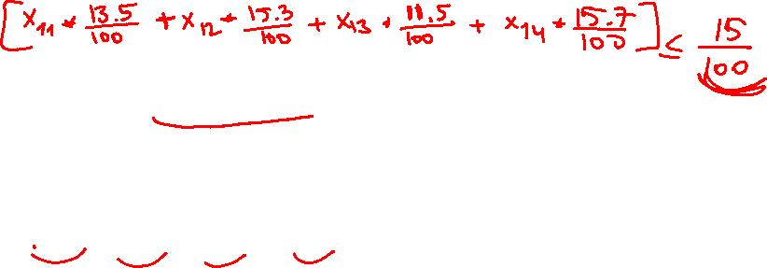
Alcohol Coefficient for all wines(row 27-31)
= [X₁₁ 13.5 + X₁₂*15.3 + X₁₃*11.5 + X₁₄*15.7] <= 15
[X₁₁+ X₁₂ + X₁₃ + X₁₄ ]
= X₁₁*13.5 + X₁₂*15.3 + X₁₃*11.5 + X₁₄*15.7 <= 15[ X₁₁ + X₁₂ + X₁₃ + X₁₄ ]
= X₁₁*13.5 + X₁₂*15.3 + X₁₃*11.5 + X₁₄*15.7 – 15*X₁₁ – 15*X₁₂ – 15*X₁₃ – 15* X₁₄ <= 0
= (-1.5)X₁₁ + (0.3)X₁₂ + (-3.5)X₁₃ + (0.7)X₁₄ <= 0

Slide 10

Alcohol Coefficient for all wines for at least 10% constraint
= [X₁₁ 13.5 + X₁₂*15.3 + X₁₃*11.5 + X₁₄*15.7] => 10
[X₁₁+ X₁₂ + X₁₃ + X₁₄ ]
= X₁₁*13.5 + X₁₂*15.3 + X₁₃*11.5 + X₁₄*15.7 => 10[ X₁₁ + X₁₂ + X₁₃ + X₁₄ ]
= X₁₁*13.5 + X₁₂*15.3 + X₁₃*11.5 + X₁₄*15.7 – 10*X₁₁ – 10*X₁₂ – 10*X₁₃ – 10* X₁₄ => 0
= (3.5)X₁₁ + (5.3)X₁₂ + (1.5)X₁₃ + (5.7)X₁₄ => 0
This implies all the coefficients are non-negative, and the net result will not be negative, which prompts us to disregard this constraint on the excel spreadsheet.

Slide 11
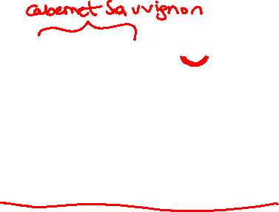
Varietal wine Coefficient for all Cabernet wines(row 32-35)
= [X₁₁ + X₁₂ + X₁₃ ] => 0.75
[X₁₁+ X₁₂ + X₁₃ + X₁₄ ]
= X₁₁ + X₁₂ + X₁₃ => 0.75[ X₁₁ + X₁₂ + X₁₃ + X₁₄ ]
= X₁₁ + X₁₂ + X₁₃– 0.75*X₁₁ – 0.75*X₁₂ – 0.75*X₁₃ – 0.75* X₁₄ => 0
= (0.25)X₁₁ + (0.25)X₁₂ + (0.25)X₁₃ + (-0.75)X₁₄ => 0

Slide 12
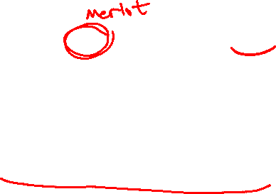
Varietal wine Coefficient for Merlot wines(row 36)
= [X₁₄] => 0.75
[X₁₁+ X₁₂ + X₁₃ + X₁₄ ]
= X₁₄ => 0.75[ X₁₁ + X₁₂ + X₁₃ + X₁₄ ]
= X₁₄– 0.75*X₁₁ – 0.75*X₁₂ – 0.75*X₁₃ – 0.75* X₁₄ => 0
= (-0.75)X₁₁ + (-0.75)X₁₂ + (-0.75)X₁₃ + (0.25)X₁₄ => 0

Slide 13

Vintage year Coefficient for Cabernet wines(row 37)
= [X₁₁ + X₁₃ ] => 0.95
[X₁₁+ X₁₂ + X₁₃ + X₁₄ ]
= X₁₁ + X₁₃ => 0.95[ X₁₁ + X₁₂ + X₁₃ + X₁₄ ]
= X₁₁ + X₁₃– 0.95*X₁₁ – 0.95*X₁₂ – 0.95*X₁₃ – 0.95* X₁₄ => 0
= (0.05)X₁₁ + (-0.95)X₁₂ + (0.05)X₁₃ + (-0.95)X₁₄ => 0

Slide 14
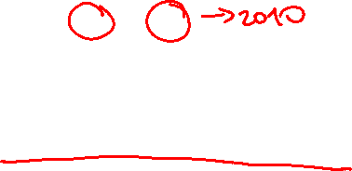
Vintage year Coefficient for Cabernet wines(row 38)
= [X₂₂ + X₂₄ ] => 0.95
[X₂₁+ X₂₂ + X₂₃ + X₂₄ ]
= X₂₂ + X₂₄ => 0.95[ X₂₁ + X₂₂ + X₂₃ + X₂₄ ]
= X₂₂ + X₂₄– 0.95*X₂₁ – 0.95*X₂₂ – 0.95*X₂₃ – 0.95* X₂₄ => 0
= (-0.95)X₂₁ + (0.05)X₂₂ + (-0.95)X₂₃ + (0.05)X₂₄ => 0

Slide 15
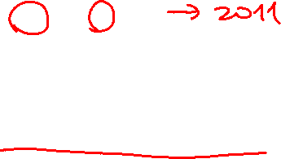
Vintage year Coefficient for Cabernet wines(row 39)
= [X₃₁ + X₃₃ ] => 0.95
[X₃₁+ X₃₂ + X₃₃ + X₃₄ ]
= X₃₁ + X₃₃ => 0.95[ X₃₁ + X₃₂ + X₃₃ + X₃₄ ]
= X₃₁ + X₃₃– 0.95*X₃₁ – 0.95*X₃₂ – 0.95*X₃₃ – 0.95* X₃₄ => 0
= (0.05)X₃₁ + (-0.95)X₃₂ + (0.05)X₃₃ + (-0.95)X₃₄ => 0

Slide 16

Vintage viticulture Coefficient for Cabernet wines(row 40)
= [X₁₁ + X₁₄ ] => 0.85
[X₁₁+ X₁₂ + X₁₃ + X₁₄ ]
= X₁₁ + X₁₄ => 0.85[ X₁₁ + X₁₂ + X₁₃ + X₁₄ ]
= X₁₁ + X₁₄– 0.85*X₁₁ – 0.85*X₁₂ – 0.85*X₁₃ – 0.85* X₁₄ => 0
= (0.15)X₁₁ + (-0.85)X₁₂ + (-0.85)X₁₃ + (0.15)X₁₄ => 0

Slide 17

Vintage viticulture Coefficient for Cabernet wines(row 41-42)
= [X₂₂ + X₂₃ ] => 0.85
[X₂₁+ X₂₂ + X₂₃ + X₂₄ ]
= X₂₂ + X₂₃ => 0.85[ X₂₁ + X₂₂ + X₂₃ + X₂₄ ]
= X₂₂ + X₂₄– 0.85*X₂₁ – 0.85*X₂₂ – 0.85*X₂₃ – 0.85* X₂₄ => 0
= (-0.85)X₂₁ + (0.15)X₂₂ + (0.15)X₂₃ + (-0.85)X₂₄ => 0

